Slide 1

NASA & Java - Mars

Slide 2
NASA's Mars missions involve cutting-edge technology, and they often use programming languages like Java for various purposes. Java is known for its platform independence, which means that code written in Java can run on different systems without modification.
Introduction

Slide 3
1. In the context of NASA's Mars missions, Java might be used in different aspects of the mission. For example, in the software development for the rovers or landers, Java could be employed to create applications that control the spacecraft's instruments, analyze data, or facilitate communication between different components of the mission. 2. Additionally, Java is commonly used in the development of ground-based mission control systems. These systems help NASA engineers and scientists monitor the mission, send commands to the spacecraft, and receive and analyze data sent back from Mars. In summary, while I don't have specific details about which exact missions or components use Java, it's reasonable to assume that Java or similar programming languages play a role in the software infrastructure supporting NASA's Mars missions.
Uses of java

Slide 4
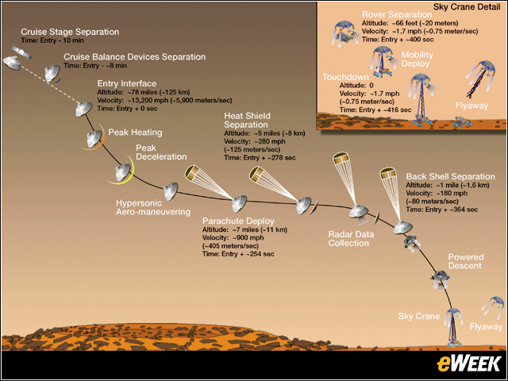
Uses of java

Slide 5
NASA’s Curiosity Mars Rover Features Java-Based Simulator, Commercial Software Support https://www.eweek.com/networking/nasa-s-curiosity-mars-rover-features-java-based-simulator-commercial-software-support/
Uses of java

